Slide 1
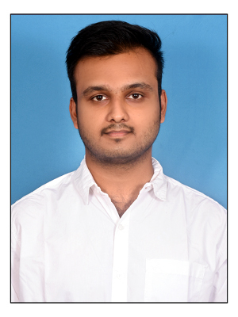

Student Details
Name: Madineni Monish
SkillsBuild Email Id: monish.madhineni@gmail.com
College name: SRM institute of science and technology
College State: Tamil Nadu
Internship Domain and internship start and End date: Cyber security and 13/10/2023 and 24/11/2023

Slide 2
PROJECT TITLE/Problem Statement
Title : Steganography GUI Application for Secure Communication
Problem Statement : It is critical to have secure communication in the modern digital world. Even while they work well, traditional encryption techniques can not always offer the appropriate degree of secrecy. In order to solve this issue, the project creates an intuitive Graphical User Interface (GUI) application for steganography, a method that conceals confidential data inside image files. By allowing users to discreetly communicate through photos, the application adds another degree of security.

Slide 3
AGENDA
The goal of this project is to develop a user-friendly "Steganography GUI Application for Secure Communication," which will solve limitations in standard encryption by implementing the Least Significant Bit (LSB) approach for picture steganography. The user-friendly interface makes it simple to open, save, hide, and expose messages within photographs. We emphasise practical applicability and the project's relevance in delivering heightened security through unobtrusive message concealing in a live presentation. Our accomplishments centre upon achieving project goals for safe and user-friendly communication. Looking ahead, we foresee additional refinements and extensions, establishing the project as a basis for steganography developments. The lecture finishes with an invitation to the audience to provide feedback and participate in conversations about the shifting environment of secure communication.

Slide 4
PROJECT OVERVIEW
This project centers on creating the "Steganography GUI Application for Secure Communication," aiming to provide a user-friendly platform for concealing information within images. Recognizing limitations in traditional encryption, our focus is on implementing the Least Significant Bit (LSB) method for image steganography, ensuring enhanced security with minimal visual impact. The intuitive GUI encompasses key features for opening, saving, hiding, and revealing messages within images. Through a live demonstration, we showcase the practical application, emphasizing functionality and ease of use. The project's significance lies in heightened security through inconspicuous message concealment, coupled with a user-friendly interface for broad accessibility. Our achievements hinge on realizing project objectives, fostering secure and user-friendly communication. Looking forward, we envision future enhancements and expansions, positioning this project as a foundation for advancements in steganography. The presentation concludes by inviting audience feedback, suggestions, and discussions on the evolving landscape of secure communication.

Slide 5
WHO ARE THE END USERS of this project?
Individuals seeking a safe mode of communication using concealed information inside photographs are among the end users of the "Steganography GUI Application for Secure Communication" project. This includes personal users who want private communication and organisations who prioritise secure internal communications. Potential end users include security experts, researchers, developers, and educational institutions investigating steganography techniques and applications. The user-friendly interface of the project caters to a varied audience, making it accessible to persons with various technical expertise and unique communication needs.

Slide 6
YOUR SOLUTION AND ITS VALUE PROPOSITION
The "Steganography GUI Application for Secure Communication," our solution, is a comprehensive software application developed to meet the demand for secure and discrete communication. In contrast to standard encryption methods, our technology uses steganography, especially the Least Significant Bit (LSB) approach, to disguise information within pictures, ensuring greater security with minimum visual effect. The user-friendly interface allows for simple activities, such as opening, saving, hiding, and revealing text within photos. This solution is beneficial to people and organisations looking for a secure communication technique that combines accessibility with increased secrecy. It provides a practical and straightforward way to protecting sensitive information, making it an excellent alternative for individuals that value security as well as user-friendliness in their digital communication practises.

Slide 7
How did you customize the project and make it your own
Intuitive GUI Design: Our customization prioritizes a user-friendly graphical interface, ensuring simplicity and effectiveness for users of all technical levels.
LSB Steganography Technique: We specifically implement the Least Significant Bit (LSB) method, providing enhanced security with minimal visual impact on carrier images.
Resource Path Handling: Our solution addresses resource path management, ensuring robust deployment and adaptability across different operating environments.
Live Demonstration Focus: A key feature is the emphasis on live demonstrations, showcasing the practical application of steganography in real-time for user understanding.
Versatility and Adaptability: The project stands out for its versatility, combining accessibility, security, and adaptability, making it suitable for a broad audience and various scenarios.

Slide 8
MODELLING
The main frameworks and libraries used in the "Steganography GUI Application for Secure Communication" project are:
Tkinter: A Python GUI framework for creating the graphical user interface.
Pillow (Python Imaging Library): Used for opening, manipulating, and saving various image file formats.
os: A module for interacting with the operating system, employed for file path operations.
Stegano : A library used for image steganography, with the lsb module utilized for data hiding and revealing.
sys: A module used for system-specific functionality, particularly for handling resource paths, especially in the context of PyInstaller packaging.

Slide 9
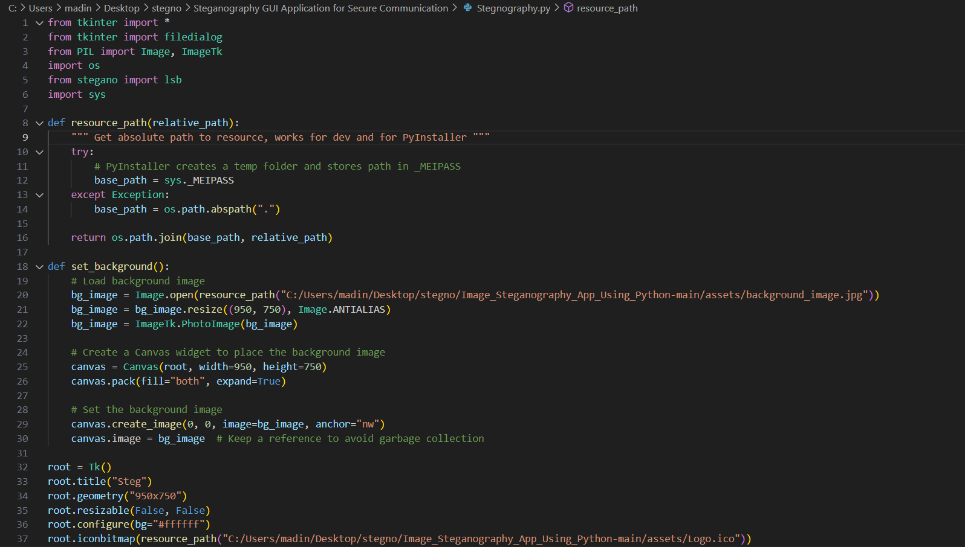
Modelling

Slide 10
Results
The "Steganography GUI Application for Secure Communication" project has delivered a user-friendly interface for seamlessly hiding and revealing data within images using steganography. Through live demonstrations, the project showcased its practical application, emphasizing usability and functionality. The solution enhances communication security by concealing messages within images, and its user-friendly design ensures accessibility for individuals with diverse technical backgrounds. Future enhancements are envisioned, and the project concluded with an invitation for feedback, underlining its commitment to continuous improvement and collaboration.

Slide 11
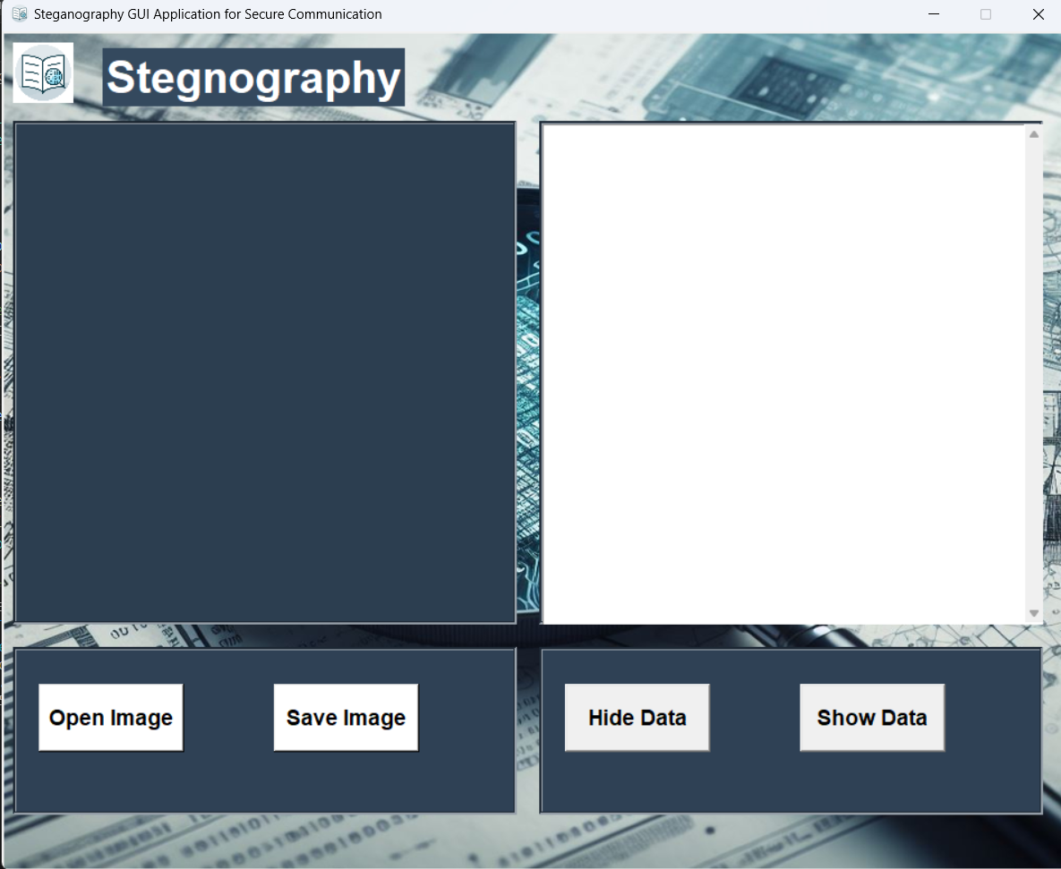
Result: When You Run The Program The GUI Interface Will Pop As Below

Slide 12
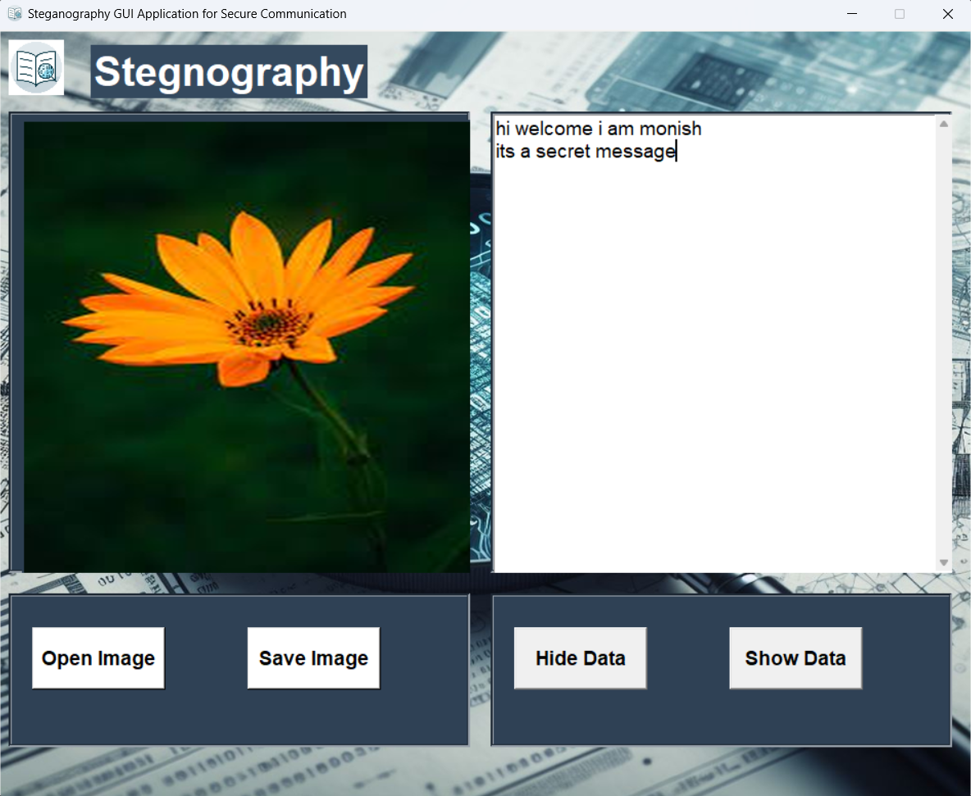
Result
For encoding a message:
-->Select the "Open Image" button.
-->Choose the desired image and input the message for concealment.
-->Select "Save" to generate the encoded image.

Slide 13
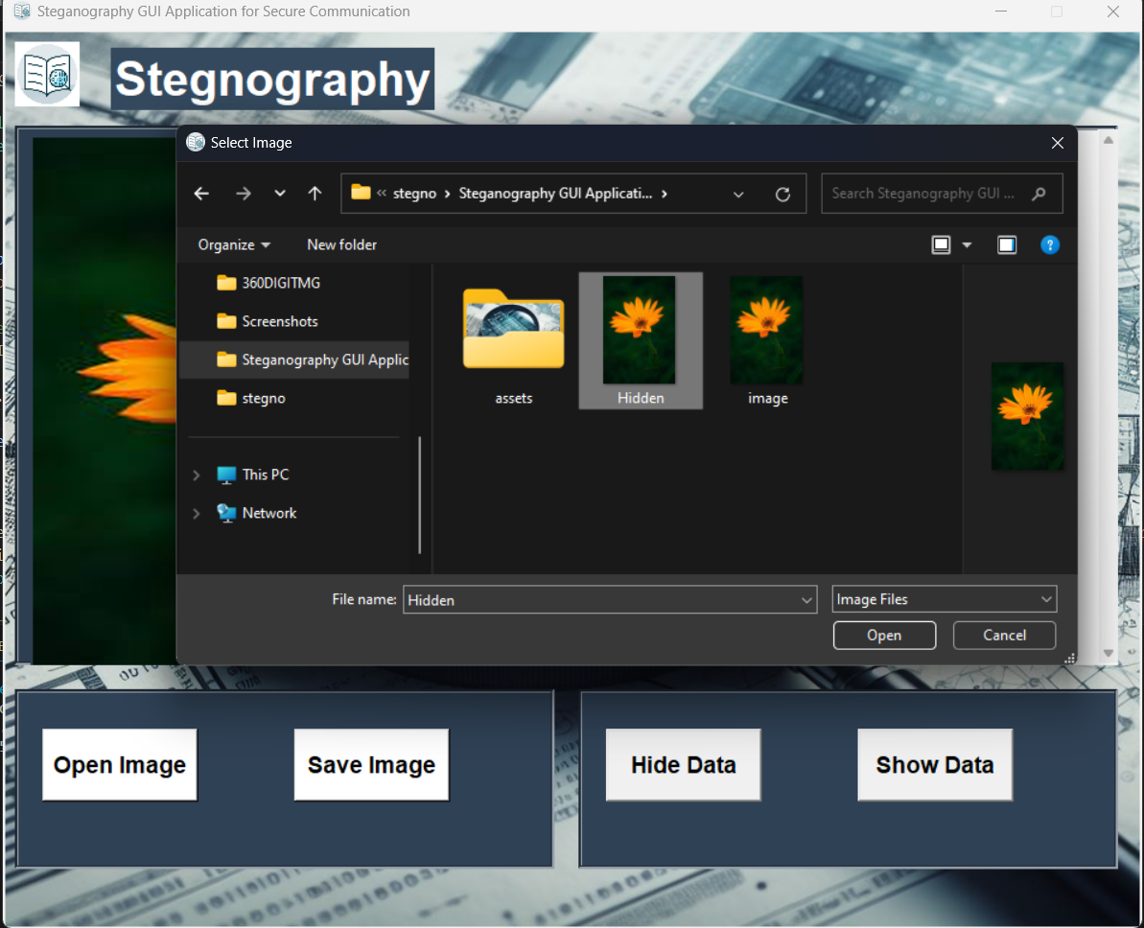
result
For decoding a message:
-->Choose the "Open Image" button.
-->Pick the image containing the concealed message.
-->Click "Show Data" to unveil the hidden message.

Slide 14
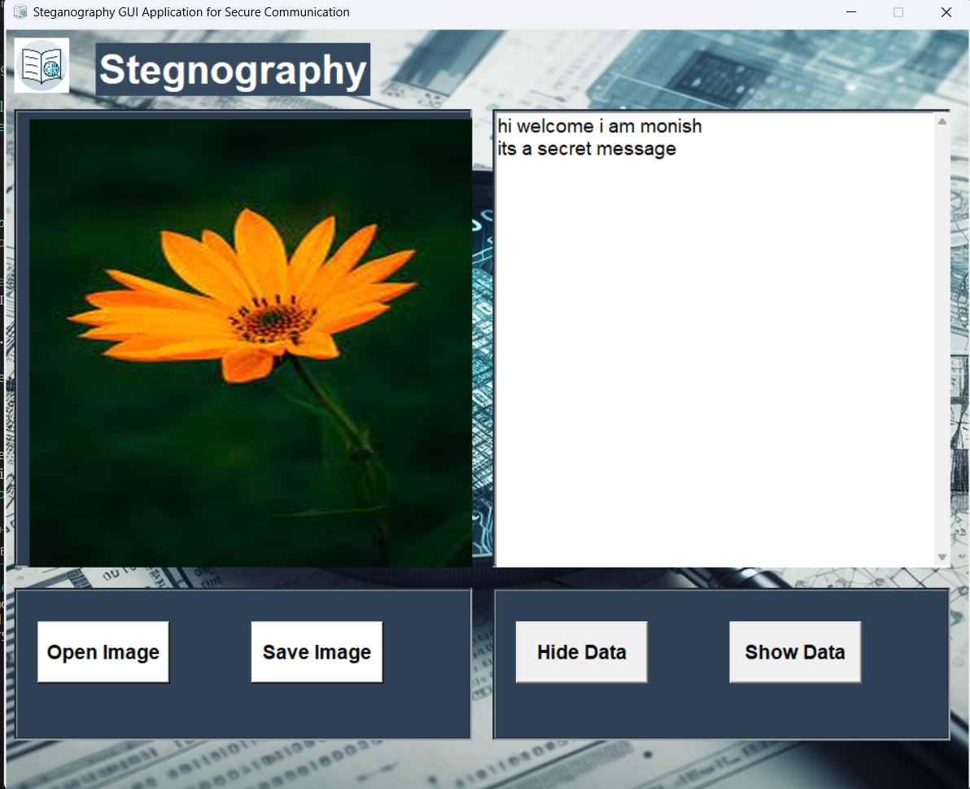
Result

Slide 15
links
https://github.com/madinenii/Stegnography-using-LSB-

